Slide 1
Blazor – C# in the Browser
Nikolay Kostov
Solutions Architect, ZenCodeo
http://nikolay.it

Slide 2
What is Blazor?
An experimental single-page web app framework using .NET, C# and HTML that runs in the browser
Do full-stack .NET development using stable and consistent tools, languages, models, and APIs both in the browser and on the server
Runs in all browsers and implements .NET Standard (no plugins needed)
Blazor runs on WebAssembly, giving you native performance in the browser and a trusted security sandbox
JavaScript interop allows easily interact with your existing JavaScript code
Open-source & free (https://github.com/aspnet/Blazor)

Slide 3
Blazor Features
A component model for building composable UI (using C# in the browser)
Layouts, Pages and Components (using Razor)
Built-in Routing and Data-binding
Easy Dependency Injection (similar to ASP.NET Core)
JavaScript Interop (two-way)
Server-side Rendering (as of version 0.5)
Rich IntelliSense and tooling (Visual Studio with Blazor extension)
Initial ReSharper support for Blazor

Slide 4
Blazor is a work in progress
Still not recommended for a production development
Marked as experimental by Microsoft
Debugging of the client code is still not supported
Console.WriteLine() to the rescue
Full exception messages can be found in the console
Few .NET Standard methods are still not implemented in Blazor
Forms and validation aren’t yet built in to Blazor
The team is working on a smaller app size, better IntelliSense and tooling
View opened issues: https://github.com/aspnet/Blazor/issues

Slide 5
What is WebAssembly (WASM)?
WebAssembly is a binary instruction format for a stack-based virtual machine
W3C Standard
Lower level than JavaScript
Similar to a traditional assembly language with small instruction set
JS Interop
WebAssembly can work along with JavaScript in two-way integration
Supported by major browsers: https://caniuse.com/#feat=wasm
Polyfill: asm.js can execute .wasm files in JavaScript (it did before WebAssembly)

Slide 6
How .NET runs in the WebAssembly?
The Mono runtime is the virtual machine that runs .NET code for Blazor
Started as a separate project to run .NET on Linux now runs on browser and Xamarin
Mono supports .NET Standard 2.0
Mono runtime is compiled to WebAssembly (mono.wasm file)
The actual .dll files are downloaded as-is and ran by the Mono runtime
Blazor uses Mono’s IL Linker to reduce the size of your app
The whole Mono with the required dll files are about 4.5 MB

Slide 7
Blazor 0.5.1 Prerequisites
Visual Studio 2017 (15.7 or later)
with the ASP.NET and web development workload selected
https://visualstudio.microsoft.com/downloads/
.NET Core 2.1 SDK (2.1.300 or later 2.1.3xx)
https://www.microsoft.com/net/download
ASP.NET Core Blazor Language Services extension
https://marketplace.visualstudio.com/items?itemName=aspnet.blazor

Slide 8
DEMO
Look inside the default Blazor template

Slide 9
DEMO
MusicX – an example Spotify-like application written in Blazor

Slide 10
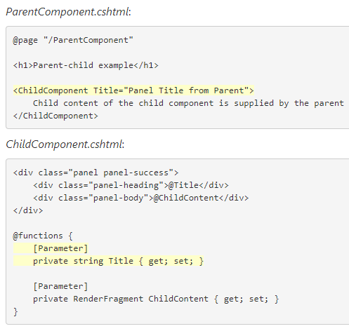
Components in Blazor
Can be used to represent a single text field as well as a whole page
Similar to AngularJS
Component can contain any number of other components
Components are compiled to .NET classes
That’s where @using, @inject, @functions, @inherits come into play in the .cshtml file
Components can have parameters
The base component is App.cshtml
_ViewImports declares the MainLayout

Slide 11
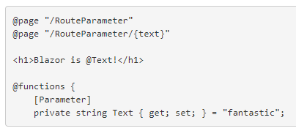
Routing in Blazor
When a *.cshtml file with an @page directive is compiled, the generated class is given a RouteAttribute specifying the route template
At runtime, the router looks for component classes with a RouteAttribute and renders whichever component has a route template that matches the requested URL
We can use route parameters to populate the corresponding component parameters with the same name (case insensitive)

Slide 12
Dependency Injection
Same as the built-in DI in ASP.NET Core
Registration is done in the ConfigureServices() method of the client web application
services.AddSingleton<IApplicationState, ApplicationState>();
Services can be Singleton and Transient (Scoped = Singleton)
Default services: IUriHelper and HttpClient
Using in components:
@inject IApiClient ApiClient

Slide 13
Lifecycle of Blazor Components
Instantiate and resolve services
@implements IDisposable
IDisposable.Dispose()
Resolve parameters
OnParametersSet()
OnParametersSetAsync()
Disposal
OnInit()
OnInitAsync()
OnAfterRender()
OnAfterRenderAsync()
Resolve sub components
State has changed
Render component
StateHasChanged()

Slide 14
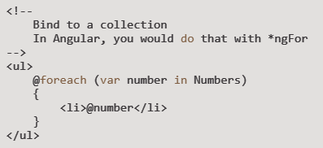
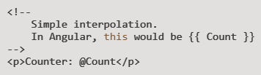
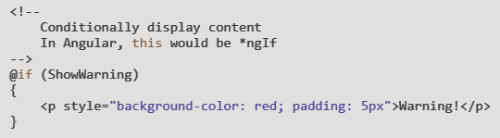
Data Binding in Blazor
Interpolation – same as in Razor
Conditional content

Slide 15
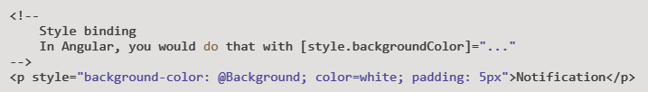

Data Binding in Blazor (2)
Style binding
Conditional CSS class

Slide 16
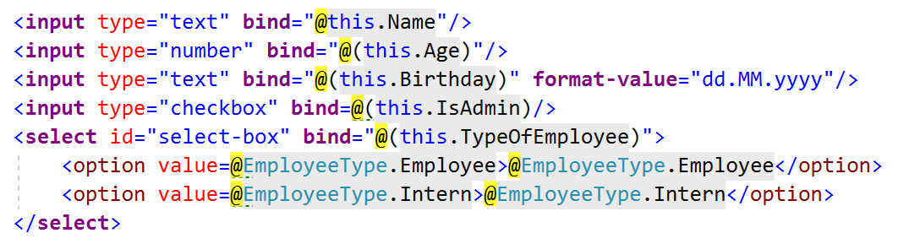
Data Binding in Blazor (3)
Two-way binding
<!-- Angular -->
<input [(ngModel)]="username">

Slide 17
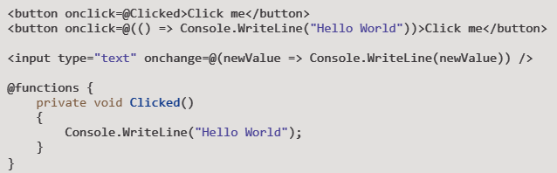
Events in Blazor
<!-- Angular -->
<button (click)="method()">
</button>
Supported events: onclick, onchange, onkeypress and many more: EventHandlers.cs

Slide 18
JS Interop: Call JavaScript from .NET
Blazor and WebAssembly cannot directly access the Browser’s DOM API
The JavaScript interop provides a means of filling the gap
window.myNamespace = {
showPrompt: function (message) {
return prompt(message, 'Type anything here');
}
};
public static Task<string> PromptAsync(string message) {
return JSRuntime.Current.InvokeAsync<string>(
"myNamespace.showPrompt", message);
}

Slide 19
JS Interop: Call .NET from JavaScript
To invoke a static .NET method from JavaScript, use the DotNet.invokeMethod or DotNet.invokeMethodAsync functions
As of version 0.5, instance methods are also supported with DotNetObjectRef
All parameters should be deserializable from JSON. No generics and overloads.
[JSInvokable]
public static Task SomeStaticDotNetMethod()
{
}
// In JavaScript we can call it with:
DotNet.invokeMethodAsync('AssemblyName', 'SomeStaticDotNetMethod');

Slide 20
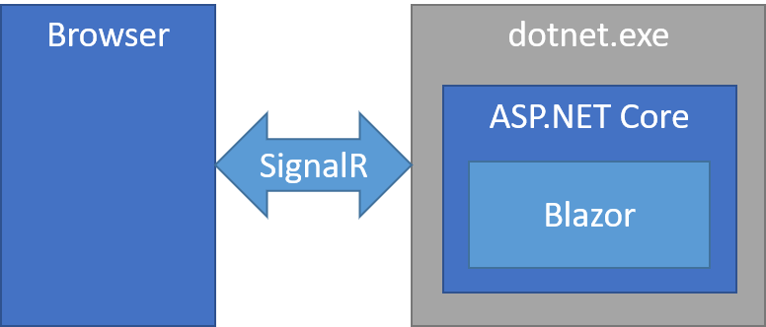
Blazor on the Server
We can run a Blazor application on the server
Event handling, UI and JavaScript interop calls are handled by a SignalR connection over the network
The .NET part runs under CoreCLR on the server instead of WebAssembly
The application looks exactly the same
Increased latency, smaller download size, full debugging experience

Slide 21
DEMO
Look inside the default Blazor (Server-side in ASP.NET Core) template

Slide 22
References, Links and Further Reading
https://blazor.net/
https://learn-blazor.com/
https://github.com/aspnet/Blazor
https://blazor.net/community.html
https://github.com/AdrienTorris/awesome-blazor

Slide 23
Thank you!
Контакти:
Blog: http://nikolay.it
GitHub: github.com/NikolayIT
LinkedIn: linkedin.com/in/nikolaykostov
Следващо събитие:
Бъдещето на .NET - тенденции

